Slide 1
LUBS2610 Intermediate Macroeconomics Semester 1, 2023-24 T.Gwiazdowski@leeds.ac.uk

Slide 2
Content
Part 1: Business Cycles and Growth
Topic 1 - Classical, Two-Period, and RBC Model
Topic 2 - New Keynesian IS-LM-PC Model
Topic 3 - Monetary Policy
Topic 4 - Fiscal Policy
Topic 5 - Supply Side Policy
Topic 6 - Inequality
Part 2: Trade and the Open Economy
Topic 7 - Trade
Topic 8 - Open Economy Macroeconomics I
Topic 9 - Open Economy Macroeconomics II

Slide 3
Topic 1 - Classical, Two-Period, and RBC Model Mitchell et al. 2019 Chapter 11 & 12 Burda & Wyplosz 2022 Chapter 6.1-6.3 & Chapter 8.1-8.2

Slide 4
Topic Overview
In Topic 1 we will learn about the classical model of the economy and subsequent models that are rooted in classical economic ideas. In particular, we will learn:
A simple classical model of the economy
A baseline two-period model of the economy
A short introduction to key ideas from real business cycle theory

Slide 5
Simple Classical Model
ASSUMPTIONS
These initial slides will allow revision of a basic model and revision of first-year or A-level mathematics.
The Assumption of the Model:
Perfectly competitive markets
Perfect information
Rational agents
One-period, static model
Individual firms maximise profits and identical households maximise utility

Slide 6
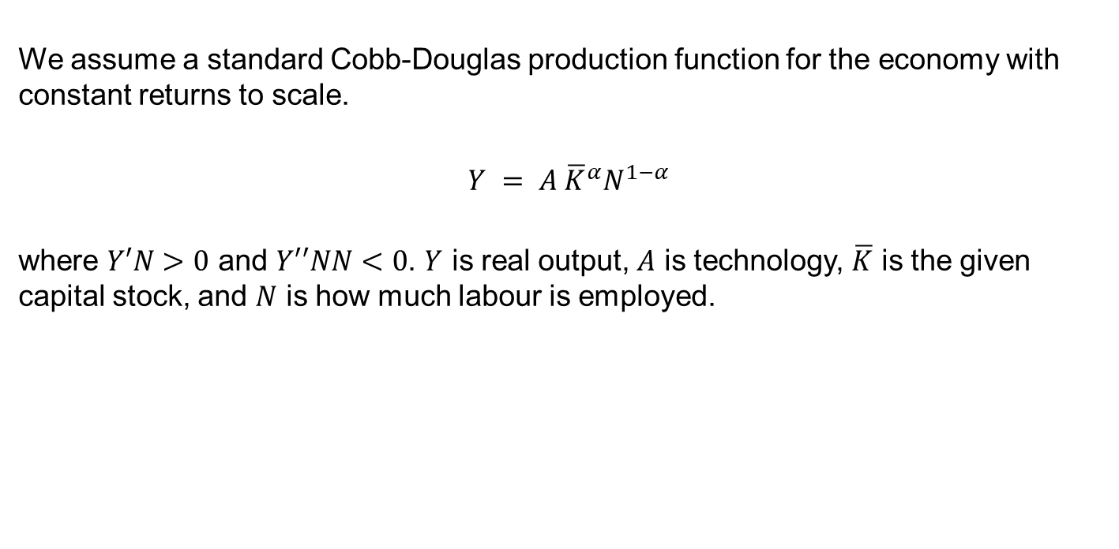
Simple Classical Model
LABOUR DEMAND
We assume a standard Cobb-Douglas production function for the economy with constant returns to scale.
$$Y = A {\overline{K}}^{α}N^{1−α}$$
where $Y′N>0$ and $Y′′NN<0$. $Y$ is real output, $A$ is technology, $\overline{K}$ is the given capital stock, and $N$ is how much labour is employed.

Slide 7
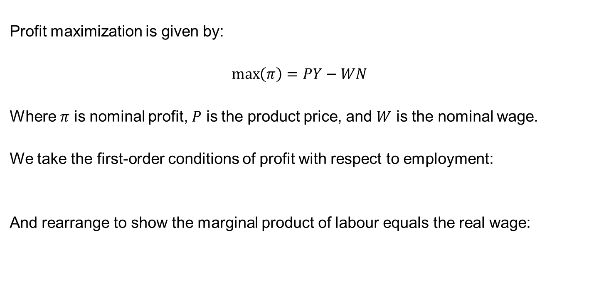
Simple Classical Model
PROFIT MAXIMISATION
Profit maximization is given by:
$$\max\left(π\right)=PY−WN$$
Where $π$ is nominal profit, $P$ is the product price, and $W$ is the nominal wage.
We take the first-order conditions of profit with respect to employment:
And rearrange to show the marginal product of labour equals the real wage:

Slide 8
Simple Classical Model
LABOUR DEMAND CURVE
Based on the previous derivation the labour demand curve is:
We can take logs of this equation so that:
This equation to shows the relationship between the real wage and employment. The relationship is negative i.e., a standard downward sloping labour demand curve.

Slide 9
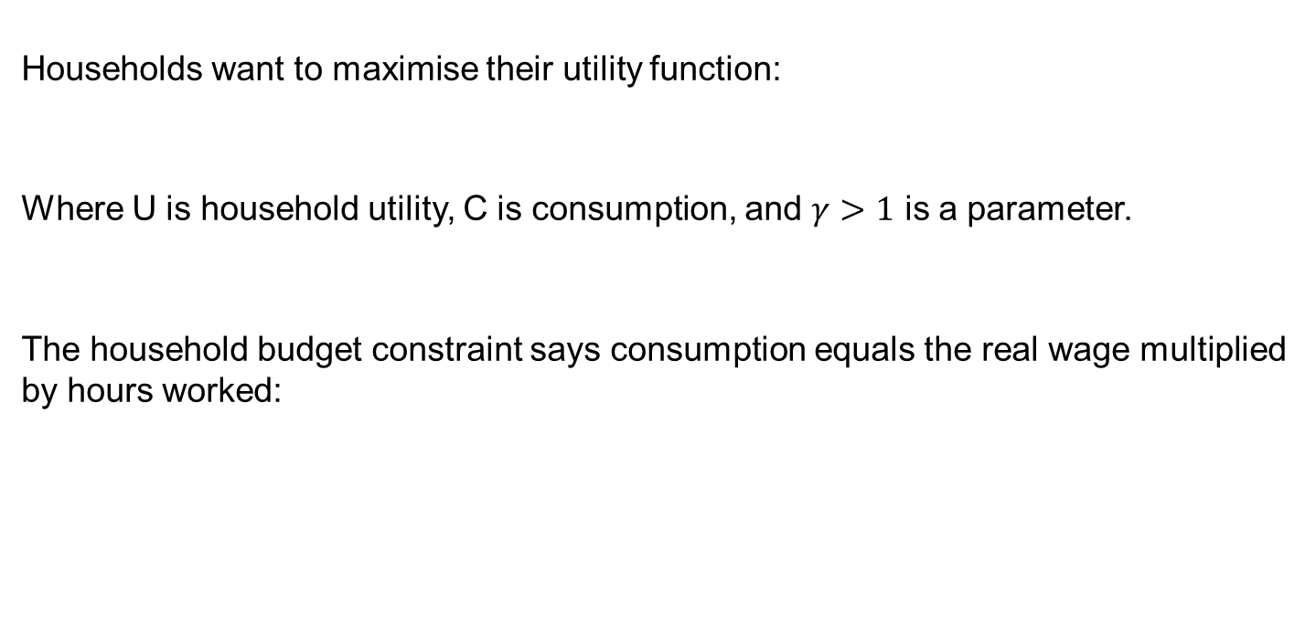
Simple Classical Model
LABOUR SUPPLY CURVE
Households want to maximise their utility function:
Where U is household utility, C is consumption, and $γ>1$ is a parameter.
The household budget constraint says consumption equals the real wage multiplied by hours worked:

Slide 10
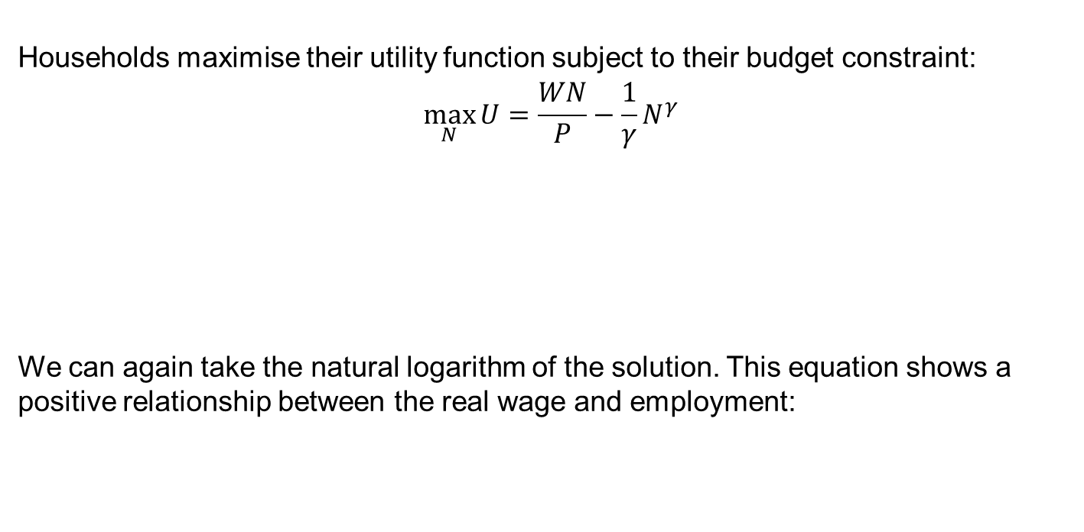
Simple Classical Model
LABOUR SUPPLY CURVE
Households maximise their utility function subject to their budget constraint:
$$\max_{N}{U}=\frac{WN}{P}−\frac{1}{γ}N^{γ}$$
We can again take the natural logarithm of the solution. This equation shows a positive relationship between the real wage and employment:

Slide 11

Simple Classical Model
EQUILIBRIUM
The equations for labour demand and labour supply are:
Labour demand: $w−p=\ln\left(1−α\right)+lnA+α\overline{k}−αn$
Labour supply: $w−p=\left(γ−1\right)n$

Slide 12
Simple Classical Model
ADDITIONAL IDEAS
The classical model, if extended, contains two more important ideas:
The Loanable Funds Market – Movements of the interest rate will ensure that savings equals investment.
Say’s Law – There can never be a generalised deficiency in aggregate demand that would result in idle productive capacity and persistent unemployment.
“Supply creates its own demand”
During the Great Depression of the 1930s there was mass unemployment in many economies, nominal interest rates reached zero and couldn’t fall further due to the zero lower bound, and this proved the staging ground for the birth of modern macroeconomics with Keynes “General Theory” published in 1936.

Slide 13
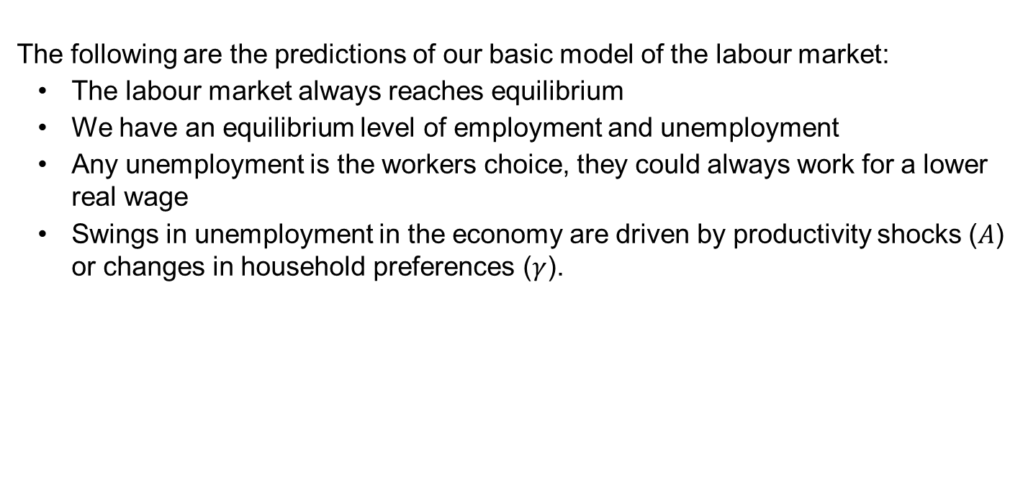
Simple Classical Model
SUMMARY
The following are the predictions of our basic model of the labour market:
The labour market always reaches equilibrium
We have an equilibrium level of employment and unemployment
Any unemployment is the workers choice, they could always work for a lower real wage
Swings in unemployment in the economy are driven by productivity shocks ($A$) or changes in household preferences ($γ$).

Slide 14
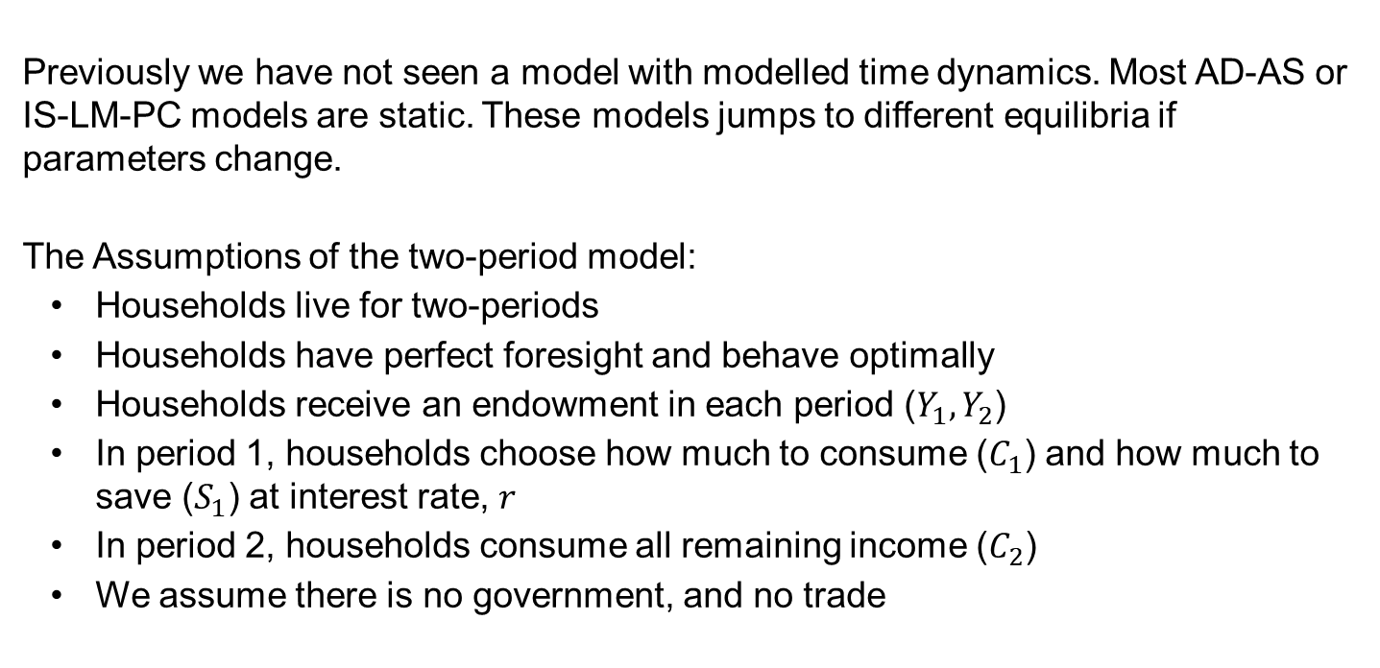
Two-Period Model
ASSUMPTIONS
Previously we have not seen a model with modelled time dynamics. Most AD-AS or IS-LM-PC models are static. These models jumps to different equilibria if parameters change.
The Assumptions of the two-period model:
Households live for two-periods
Households have perfect foresight and behave optimally
Households receive an endowment in each period ($Y_{1},Y_{2}$)
In period 1, households choose how much to consume ($C_{1}$) and how much to save ($S_{1}$) at interest rate, $r$
In period 2, households consume all remaining income ($C_{2}$)
We assume there is no government, and no trade

Slide 15
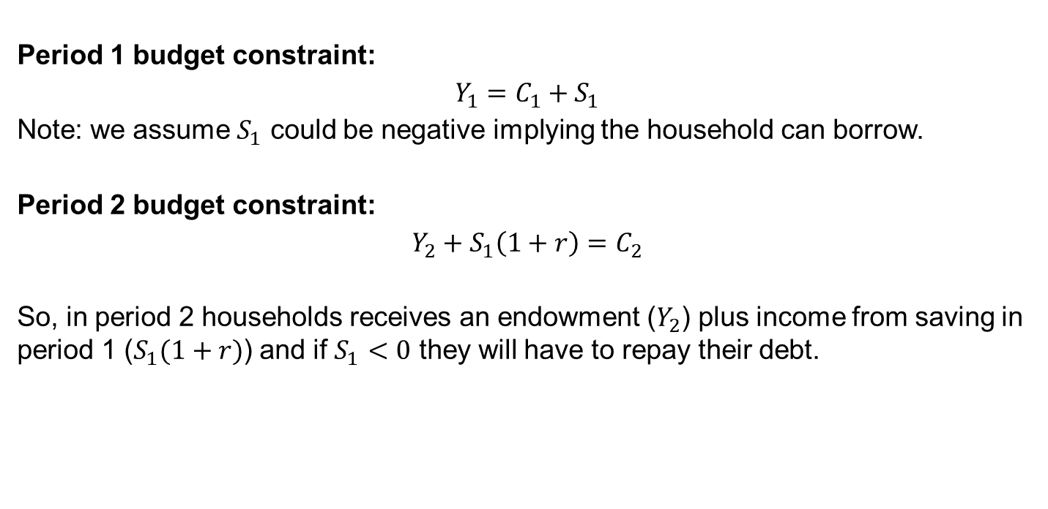
Two-Period Model
HOUSEHOLD BUDGET CONSTRAINT
Period 1 budget constraint:
$$Y_{1}=C_{1}+S_{1}$$
Note: we assume $S_{1}$ could be negative implying the household can borrow.
Period 2 budget constraint:
$$Y_{2}+S_{1}\left(1+r\right)=C_{2}$$
So, in period 2 households receives an endowment ($Y_{2}$) plus income from saving in period 1 ($S_{1}(1+r)$) and if $S_{1}<0$ they will have to repay their debt.

Slide 16

Two-Period Model
HOUSEHOLD BUDGET CONSTRAINT
Combine the equations to derive the household's lifetime budget constraint:
$$Y_{1}=C_{1}+S_{1}; Y_{2}+S_{1}\left(1+r\right)=C_{2}$$

Slide 17

Two-Period Model
AUTARKY, STUDENT, AND ATHLETE
Combine the equations to derive the household's lifetime budget constraint:
$$W=Y_{1}+\frac{Y_{2}}{1+r}$$

Slide 18
Two-Period Model
BORROWERS AND LENDERS

Slide 19
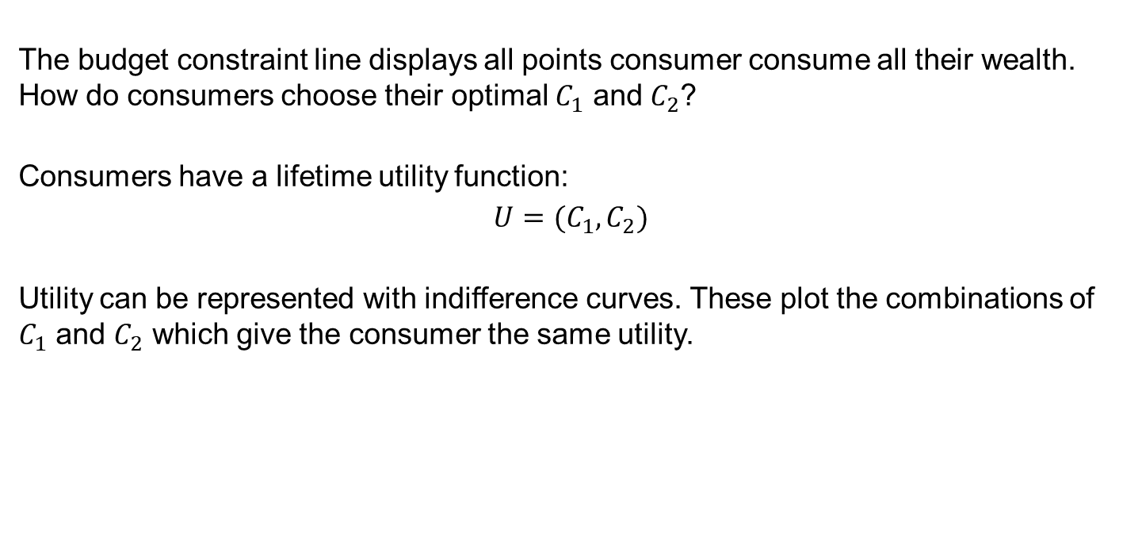
Two-Period Model
CONSUMER PREFERENCES
The budget constraint line displays all points consumer consume all their wealth. How do consumers choose their optimal $C_{1}$ and $C_{2}$?
Consumers have a lifetime utility function:
$$U=(C_{1},C_{2})$$
Utility can be represented with indifference curves. These plot the combinations of $C_{1}$ and $C_{2}$ which give the consumer the same utility.

Slide 20
Two-Period Model
CONSUMER PREFERENCES

Slide 21
Two-Period Model
CONSUMER PREFERENCES - LEONTIEF

Slide 22
Two-Period Model
CONSUMER PREFERENCES - CONSTANT SUBSTITUTION

Slide 23
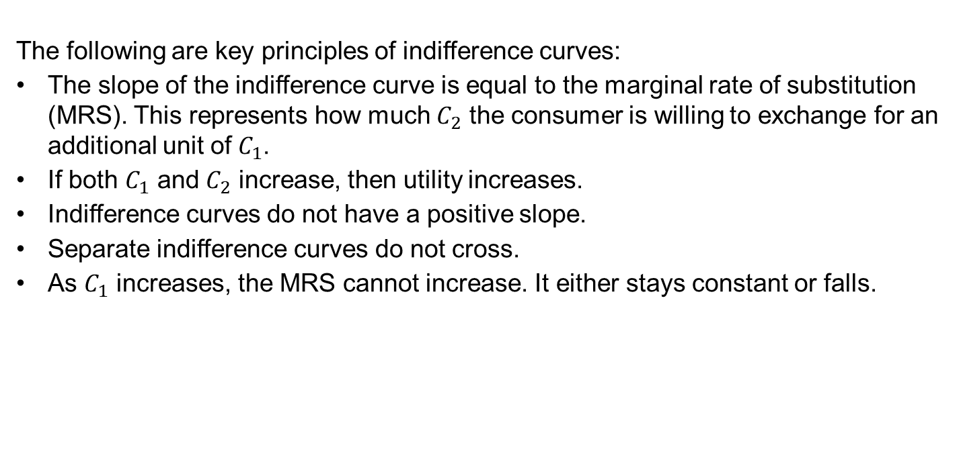
Two-Period Model
INDIFFERENCE CURVE - KEY PRINCIPLES
The following are key principles of indifference curves:
The slope of the indifference curve is equal to the marginal rate of substitution (MRS). This represents how much $C_{2}$ the consumer is willing to exchange for an additional unit of $C_{1}$.
If both $C_{1}$ and $C_{2}$ increase, then utility increases.
Indifference curves do not have a positive slope.
Separate indifference curves do not cross.
As $C_{1}$ increases, the MRS cannot increase. It either stays constant or falls.

Slide 24
Two-Period Model
OPTIMAL CONSUMPTION

Slide 25
Two-Period Model
OPTIMAL CONSUMPTION - BORROWER

Slide 26
Two-Period Model
OPTIMAL CONSUMPTION - LENDER

Slide 27

Two-Period Model
THE MATHS VIA A LAGRANGIAN
We can derive the optimal solution using maths. We want to maximise our utility subject to our constraint:
$$\max_{C_{1},C_{2}}{U(C_{1},C_{2}}) subject to C_{1}+\frac{C_{2}}{1+r}=W$$

Slide 28
Two-Period Model
THE MATHS VIA A LAGRANGIAN

Slide 29
Two-Period Model
ANALYSING A CHANGE IN INTEREST RATE

Slide 30
Two-Period Model
ANALYSING A CHANGE IN INTEREST RATE

Slide 31
Two-Period Model
ANALYSING A CHANGE IN INTEREST RATE
The change in interest rates can be decomposed into income and substitution effects.
The substitution effect shows the effect of a change in relative prices of period 1 and period 2 consumption.
Graphically, draw the NEW budget constraint tangential to the OLD IC.
The income effect shows the effect of a change in income.
Graphically, move from the point derived in the previous step to the new equilibrium.
Substitution Effect: Change in consumption from a change in relative prices, holding income constant.
Income Effect: The change in consumption from a change in income.

Slide 32
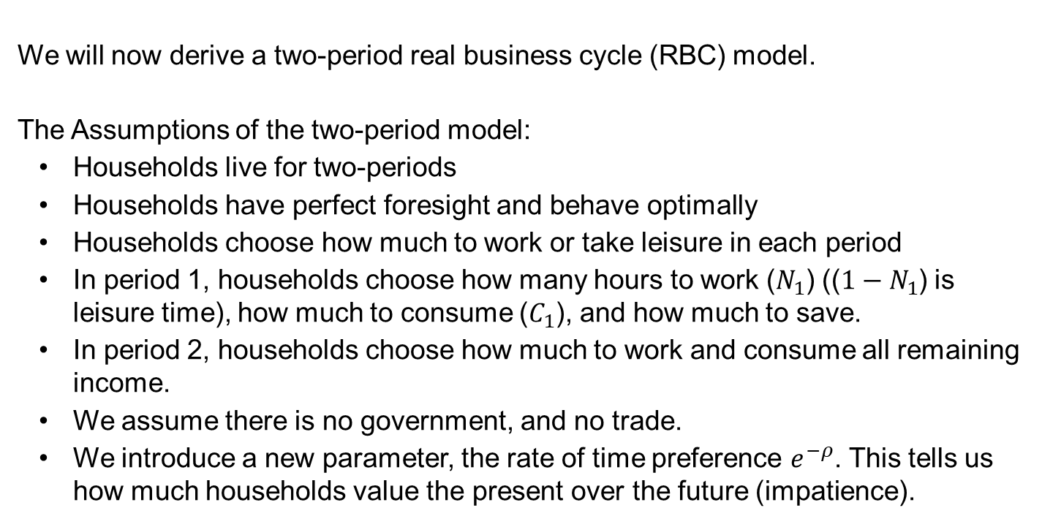
Real Business Cycle Model
ASSUMPTIONS
We will now derive a two-period real business cycle (RBC) model.
The Assumptions of the two-period model:
Households live for two-periods
Households have perfect foresight and behave optimally
Households choose how much to work or take leisure in each period
In period 1, households choose how many hours to work ($N_{1}$) (($1−N_{1}$) is leisure time), how much to consume ($C_{1}$), and how much to save.
In period 2, households choose how much to work and consume all remaining income.
We assume there is no government, and no trade.
We introduce a new parameter, the rate of time preference $e^{−ρ}$. This tells us how much households value the present over the future (impatience).

Slide 33

Real Business Cycle Model
MODEL
Household Utility:
$$U=\ln{c_{1}+b\ln{(1−N_{1}}})+e^{−ρ}[\ln{c_{2}+b\ln{(1−N_{2})}]}$$
Household’s lifetime budget constraint:
$$c_{1}+\frac{1}{1+r}c_{2}=w_{1}N_{1}+\frac{1}{1+r}w_{2}N_{2}$$
First-order conditions for $N_{1}$ and $N_{2}$:
$$\frac{b}{1−N_{1}}=λw_{1}$$
$$\frac{e^{−ρ}b}{1−N_{2}}=\frac{1}{1+r}λw_{2}$$

Slide 34
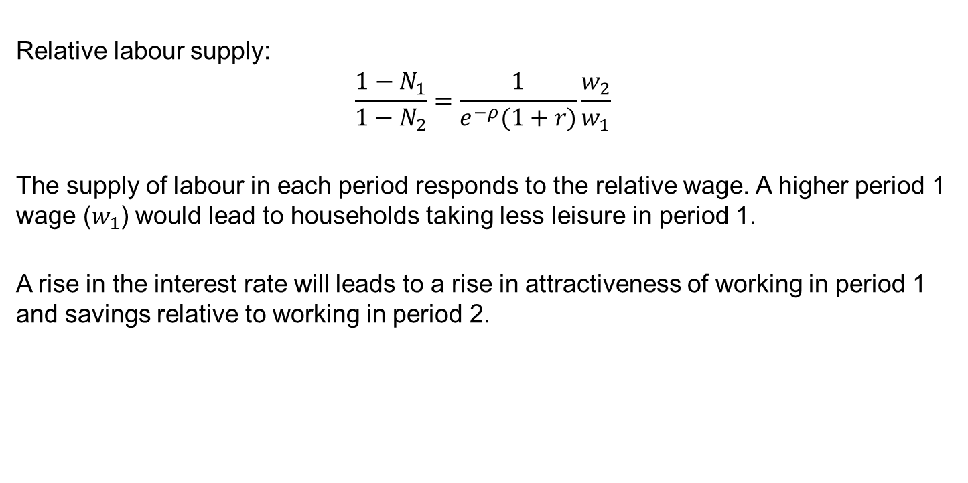
Real Business Cycle Model
MODEL
Relative labour supply:
$$\frac{1−N_{1}}{1−N_{2}}=\frac{1}{e^{−ρ}(1+r)}\frac{w_{2}}{w_{1}}$$
The supply of labour in each period responds to the relative wage. A higher period 1 wage ($w_{1}$) would lead to households taking less leisure in period 1.
A rise in the interest rate will leads to a rise in attractiveness of working in period 1 and savings relative to working in period 2.

Slide 35
Real Business Cycle Model
DISCUSSION
Do RBC models capture key features of observed fluctuations in business cycles? “Evidence suggests they do not” Romer (2012).
The model has no role for “monetary shocks” which can have important real effects.
The most likely explanation monetary shocks have real effects is if there is a departure from perfectly flexible prices and wages.
Price and wage rigidity arises when labour, credit, and goods markets depart from assumptions of perfectly competitive markets.
If developed, like the classical model, the simple RBC model requires technology to be the main driver of business cycles; however, the size of technology shocks required by models are much larger than those observed in data.
RBC models also rely on a high intertemporal substitution of labour between time periods; however, evidence suggests workers do not substitute their hours to the high level required for RBC models to match macroeconomic data.

Slide 36
Topic 1 - Summary
In this topic we have:
Learned how to derive simple classical model and its main predictions
Learned a baseline two-period economic model
Analysed the model to understand:
Why there are borrowers and lenders
How to identify optimal consumption graphically and mathematically
The income and substitution effect
Outlined a simple real business cycle model.

